Slide 1

Arch Bridge Design Competition
team member names

Slide 2
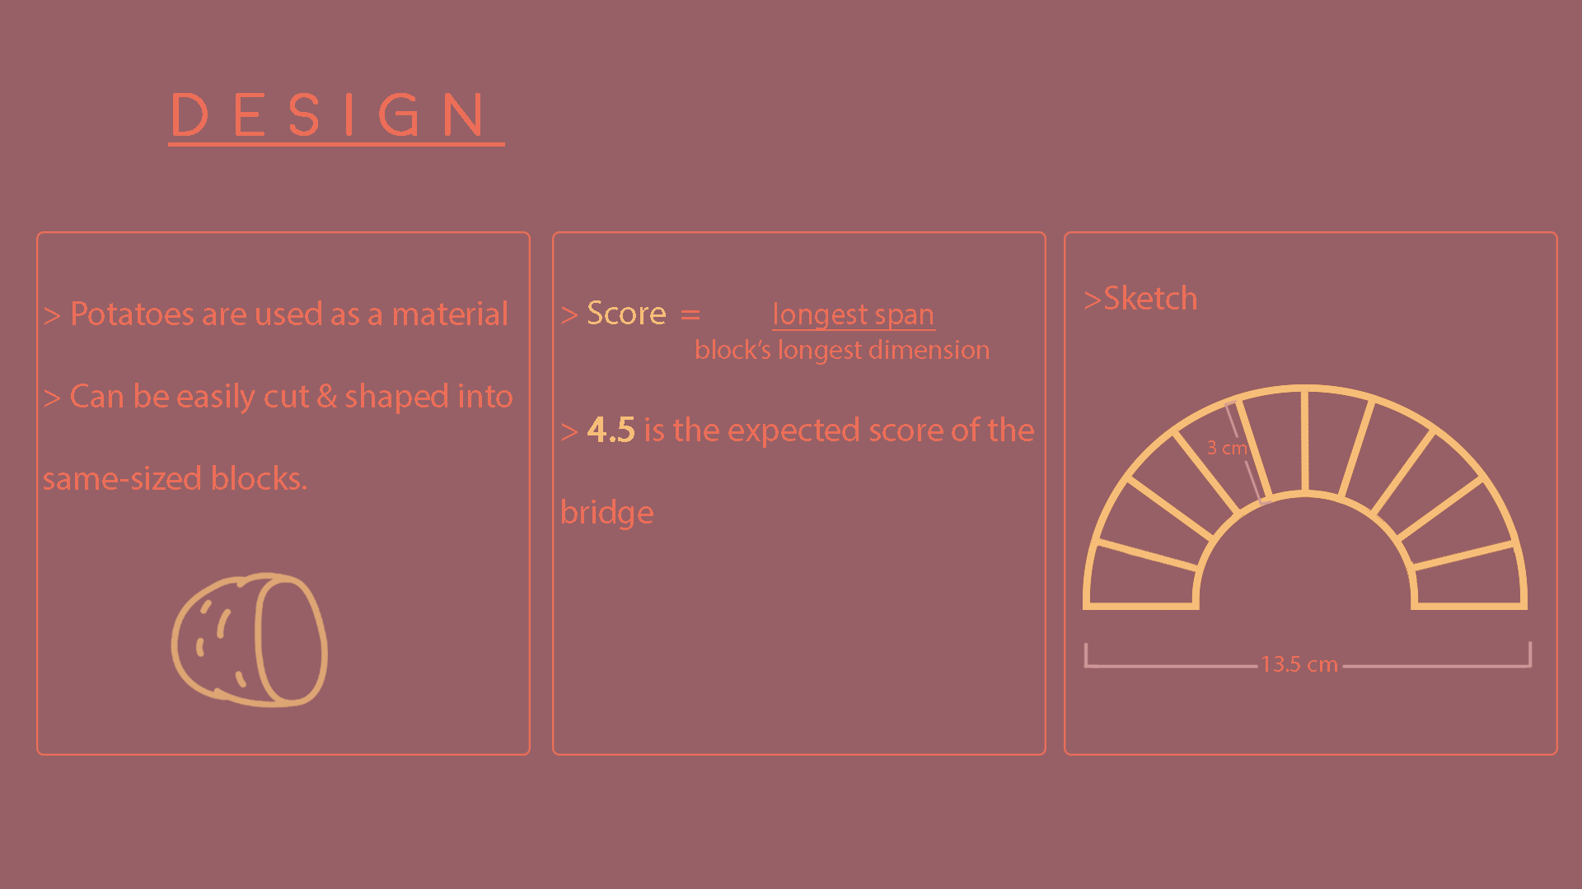

Slide 3
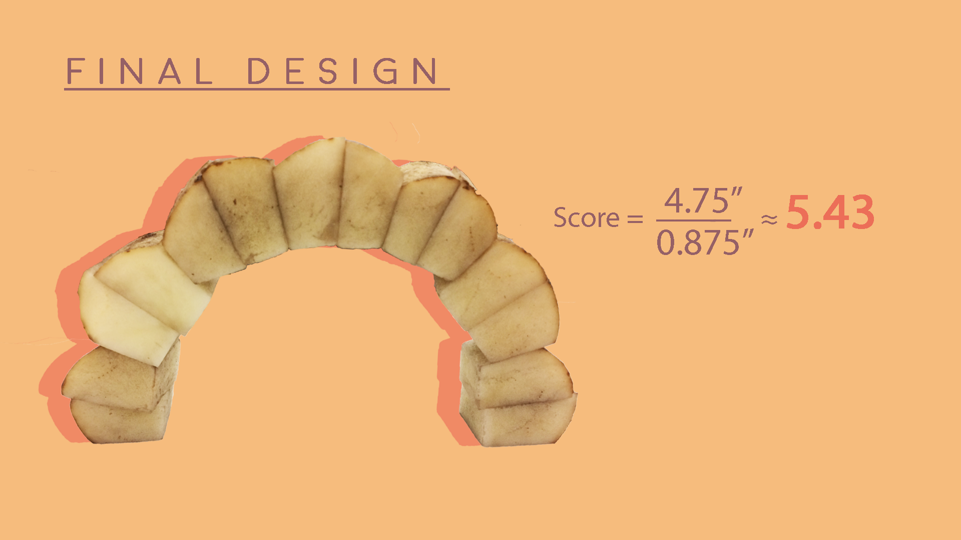

Slide 4
